Slide 1

Grant proposals writing: Lessons learned…
Prof. Jennifer Mahony
School of Microbiology & APC Microbiome Ireland

Slide 2

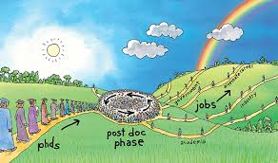

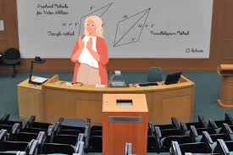
My funding journey
2020: IRC enterprise PG
2021: DAFM €1M
2021: SFI Frontiers of the Future €400k
2023: INSPIRE PD
2016: SFI – SIRG €400k
2018-present: Industry-funded projects
2003: IRC PhD funding
2013: SFI – TIDA ~€100k
2015/6: Bill & Melinda Gates Foundation ~€90k
PhD
Post-doc
Research Fellow
Lecturer
These were the successfully funded projects……

Slide 3
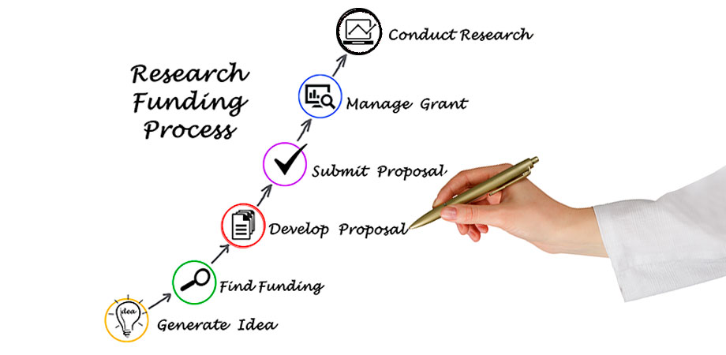
This is what we want to do but first…….

Slide 4

Things you need to know before you begin
What do you want to do?
Who can help you develop (NOT formulate!) your plan if you are early stage?
Who will fund this research?
What am I eligible to apply for?
Establish collaborative network if it can support the application/the project outcomes

Slide 5
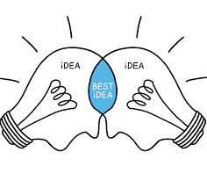






Collaborations:
Collaborators may receive no financial reward from your proposal but you are asking them to support you- give them time to prepare support letters/CVs
DORA compliant CVs may not be standard in all countries so this may take time to prepare
Identify your collaborative network- possibility of interdisciplinary/complementary approaches?
Funding landscape:
What funding programmes are you eligible to apply to? (National, EU, Philanthropic)
Who in the Research Office can support you?
Reach out to the Research Office

Slide 6

Advice for early career researchers
Choose your mentor carefully
Communicate well with your mentor & learn from them
Don’t be afraid of critique- it will make your proposals stronger
You must be an all-rounder: a scientific leader, a project manager, administrator and a financial whizz!
YOU are the leader- don’t be afraid to shine

Slide 7
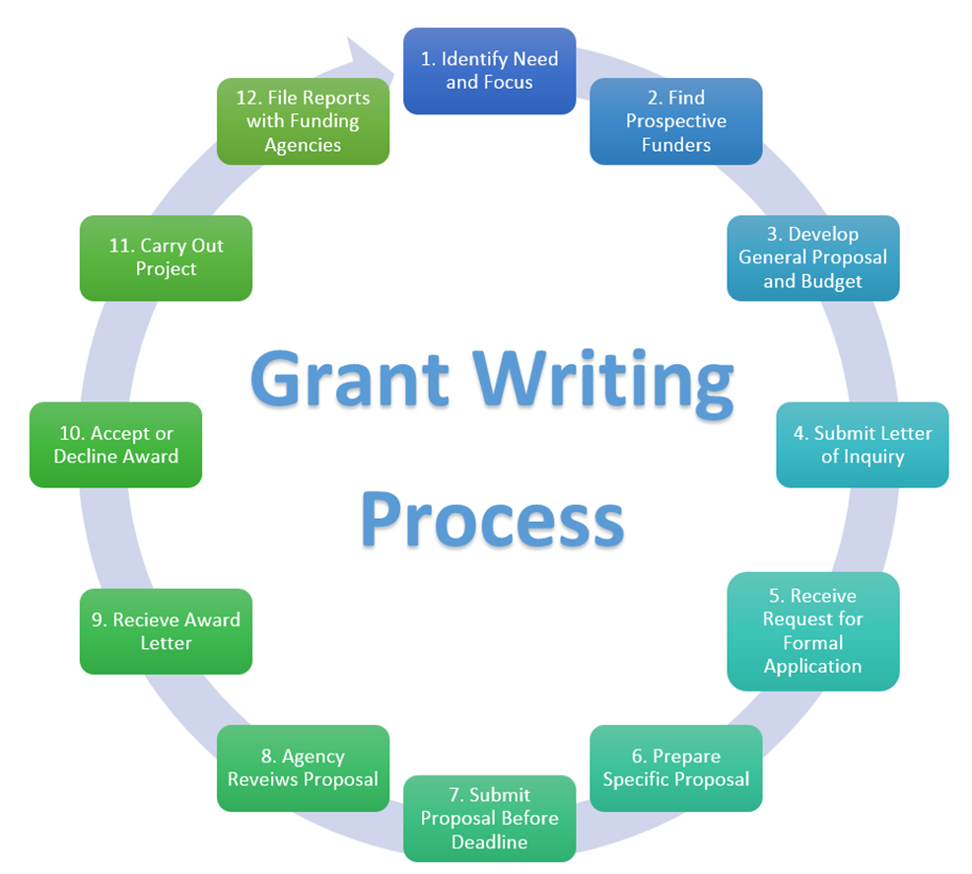
General tips
Be clear on what you are proposing, why it is important and how it is different/better than current approaches
Demonstrate how you are going to break scientific boundaries and how it will impact the field and society
Consider your budget carefully and provide a clear justification
Highlight clearly preliminary data to support your hypothesis and to provide confidence that you will succeed
Believe in what you are trying to sell
If you are not awarded, keep trying!!!

Slide 8
General tips……
Break up text with appropriate figures
Clearly identify and highlight your objectives- maybe a text box to highlight this
Present deliverables clearly
Provide clear timelines and delineate who is responsible for what activity – Gantt chart

Slide 9
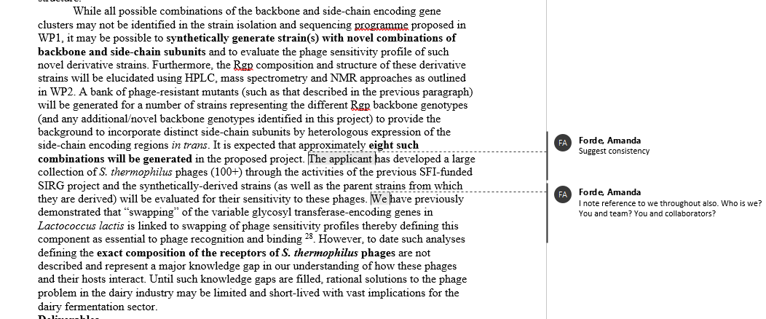
Feedback and input from research office
Highlight in boldface key words to emphasise your message
Consistency in writing approach
Taking ownership of your work and ideas
Feedback from colleagues and peers, mentors etc.
Discuss your ideas with people you trust, honest feedback

Slide 10
Summary
Planning is 90% of the application – informing all stakeholders, scientific plan, knowing the requirements
Have a clear vision of your plan
Use graphics/flow diagrams to complement the text
Allow plenty of time
Discuss, review and get feedback

